Slide 1
Park-Me
Group 5- Shriya Vaagdevi Chikati, Cassandra Lundberg,
JT Whetstone, Wenzhuo Zhao

Slide 2

Demo/Code
Link: https://x.thunkable.com/copy/dbaa5649ec29042c08a7e502901e44f5

Slide 3
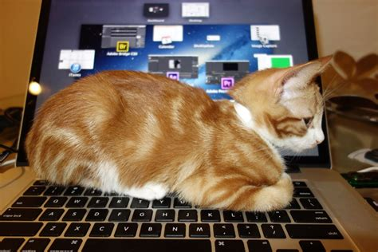
Working system
We used a “No Code” mobile app developer called Thunkable
Utilizes simple drag and drop canvas and logic code blocks to unlock all the benefits of a mobile or tablet device
Also used a third party database called Airtable with Thunkable’s open integrations to store the “Parking Database”
Includes each Level of the Parking Deck as a separate table
As well as includes a table of Users of the app, the list of Reservation times to choose from, and list of parking decks to choose from
https://airtable.com/appTUL3fMZNI6GExK/tbl5lzFcq297Jwmja/viw8hFWU6MmrLQVVk?blocks=hide
Implemented an app development platform called Firebase to control the Authentication for users signing in
Sends link to users’ email to verify once user has registered on the app
https://console.firebase.google.com/project/parkmeproject-c16a9/authentication/users

Slide 4

Functional Requirements
Will provide the ability to reserve a parking spot
Display the available spots of a parking deck
Ability to reserve a time window
Present QR code for entry into the parking deck
Present order details and arrival confirmation

Slide 5
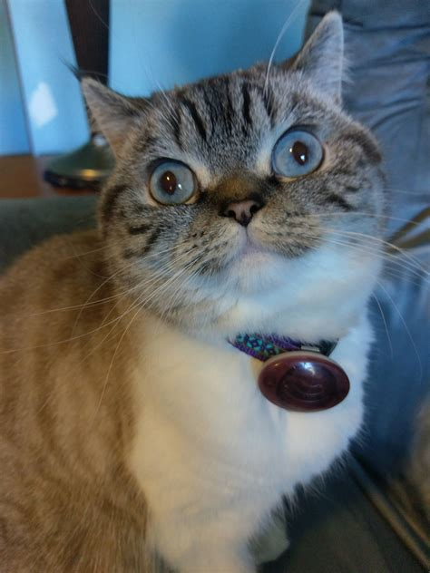
Non-Functional Requirements
Ability to update the parking database
Verifies financial information in a secure manner
Direct the user to Google Maps
Ability to handle between 100 and 350 users at a time
Updates must be resolved quickly in order to ensure priority

Slide 6

Summary of Team Experience ->
What was envisioned?
An Android application for reservation and GPS direction to a specific spot
A utilization of Map API
What were the hurdles?
TIME, RESOURCES, and GSU cooperation
What was achieved?
A basic functionality presentation as the foundation of a bigger project
A mock-up native mobile application to perform this presentation
What did we learn?
Previous presentations delved deeper into figuring out the workings of the application
Software is expensive for a reason (RAM and server computers)

Slide 7


Thank you !

